Slide 1

Simulation of a Multi-Elevator Intelligent Control System using the State Design Pattern
29/03/2026 Sapna Singh

Slide 2
PROJECT OVERVIEW
Project Title:
Smart Elevator Control System: A State Design Pattern Approach
Problem Statement :
Modern multi-storey buildings face significant challenges in transporting occupants efficiently between floors. As building height and occupancy increase, managing a fleet of elevators becomes a complex coordination problem involving varying user requests and real-time state changes.
Target User:
The target users for this system include:
Building Architects & Engineers: Who require a reliable logic framework for high-rise vertical transportation.
Software Developers: Looking for a scalable template to implement state-dependent behavior in IoT or robotic systems.
Smart Building Management Systems: That need to integrate elevator logic into a broader automated infrastructure.

Slide 3


Intelligent Control with State Pattern
Distinct Operational States
Elevator modeled as Idle, Moving Up, Moving Down, Door Open
State Design Pattern Advantage
Transitions handled by independent state objects for modularity
Decoupled Request Handling
Each state manages its own logic for ﬂoor requests

Slide 4
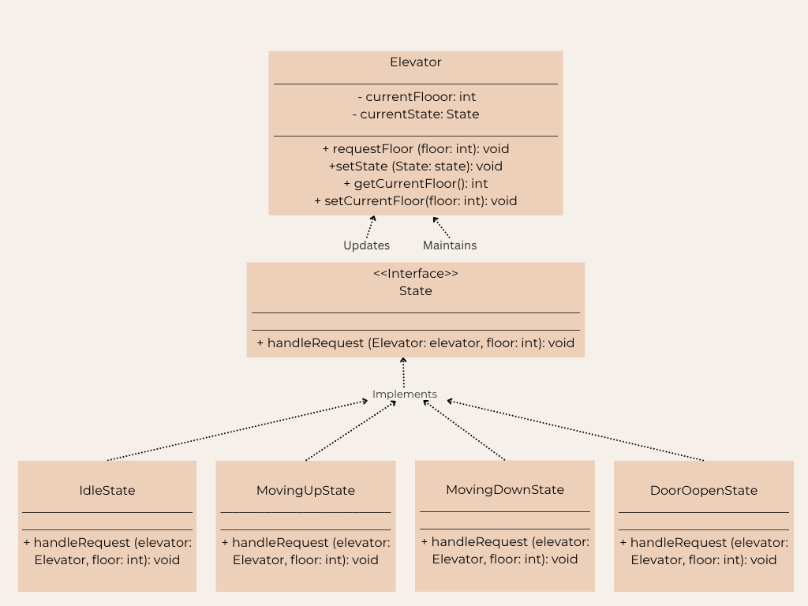
System Flow & Architecture
Delegation of Requests
Elevator forwards ﬂoor requests to its current state.
Dynamic State Transitions
•
•
States change based on user input and elevator's position.
Centralized Request Management
•A controller and queue handle
multiple simultaneous requests.

Slide 5


OOP Principles in Action
Abstraction via State Interface
Handled by the State interface.
Abstraction hides complex implementation details by showing only the necessary method signatures (handleRequest) to the user, allowing the system to focus on what an object does rather than how it does it.
Inheritance & Polymorphism in Action
Handled by the implements keyword.
Inheritance allows the concrete states (like IdleState or MovingUpState) to derive their structure from a common parent interface, promoting code reusability and establishing a clear hierarchical relationship between classes.
Encapsulation of Elevator Data
IIn your project: Handled by the Elevator class.
Encapsulation bundles the data (currentFloor) and the methods that operate on that data into a single unit, using private fields and public getters/setters to protect the internal state from unauthorized external access.
Robust Exception Handling
In a robust Elevator Management System, Exception Handling ensures that the program doesn't crash when it encounters unexpected inputs or runtime errors (like a power failure simulation or an invalid floor request).

Slide 6
technical highlights
Core Design Decision
Pattern Used: Behavioral State Design Pattern.
Decision: Replacing conditional if-else or switch logic with Object-Oriented State Objects.
Why This Was Chosen (The "Engineering" Justification)
Single Responsibility Principle: Each state (Idle, Moving, DoorOpen) is isolated in its own class, making the code easier to debug.
Open/Closed Principle: New states (like MaintenanceState or EmergencyState) can be added without modifying the existing Elevator class code.
Elimination of "State Pollution": Prevents the "spaghetti code" that happens when multiple boolean flags (e.g., isMoving, isDoorOpen) conflict with each other.
Code Logic Snippet :
if (targetFloor > currentFloor) {
elevator.setState(new MovingUpState());
} else {
elevator.setState(new MovingDownState());
}
elevator.requestFloor(targetFloor); // Delegation

Slide 7

Key Takeaways & Future Directions
State Pattern for Modularity
Elevator behaviors modeled as independent state objects Enables scalable and maintainable system design
Robust Multi-Request Handling
System manages real-time, concurrent ﬂoor requests Exception handling ensures safe operation under invalid inputs
Future Enhancements
Integrate smarter dispatch algorithms for efficiency Explore hardware integration with microcontrollers Leverage AI for predictive and adaptive elevator logic

